Slide 1


Build a Personalized Online Course Recommender System with Machine Learning
Kymberly Ayodeji
December 31, 2023

Slide 2

Outline
Introduction and Background
Exploratory Data Analysis
Content-based Recommender System using Unsupervised Learning
Collaborative-filtering based Recommender System using Supervised learning
Conclusion
Appendix

Slide 3
Introduction
As people new to machine learning have a strong desire to upskill to the necessary information to further their interest and possible career through Massive Open Online Courses (MOOC), they would benefit from a resource that recommends appropriate courses based on their previous learning history.
Our goal is to improve the learning experience by helping students quickly find new courses better aligned to their learning history via a course recommender application.

Slide 4
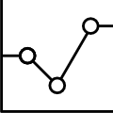
Exploratory Data Analysis

Slide 5
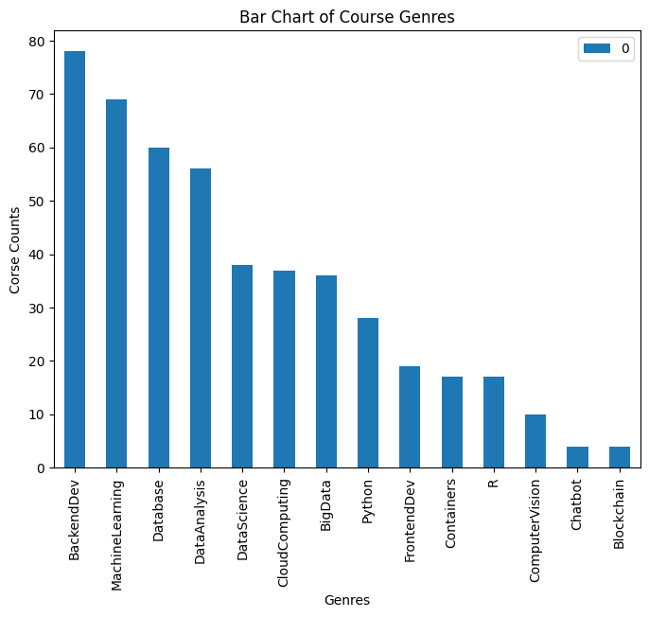
Course counts per genre
Notes:
A sorted bar chart of the total course offerings based on genre. The genres with the most courses (55-80) are related to Backend Development, Machine Learning. Database and Data Analysis. The genres with the least amount of courses (under 10) are Chatbot and Blockchain. Note: Some course fit into multiple genres.

Slide 6
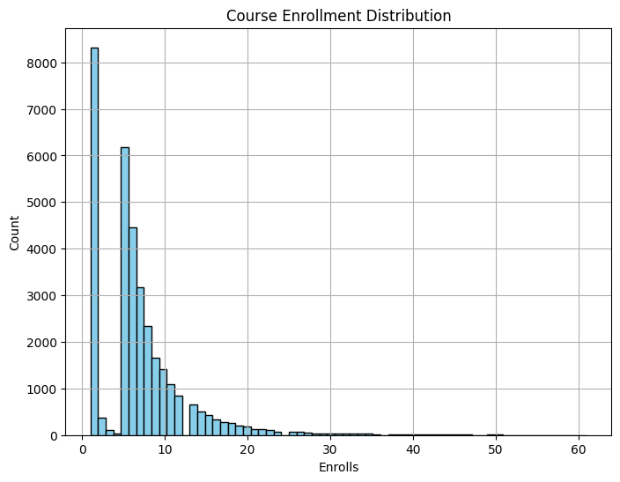
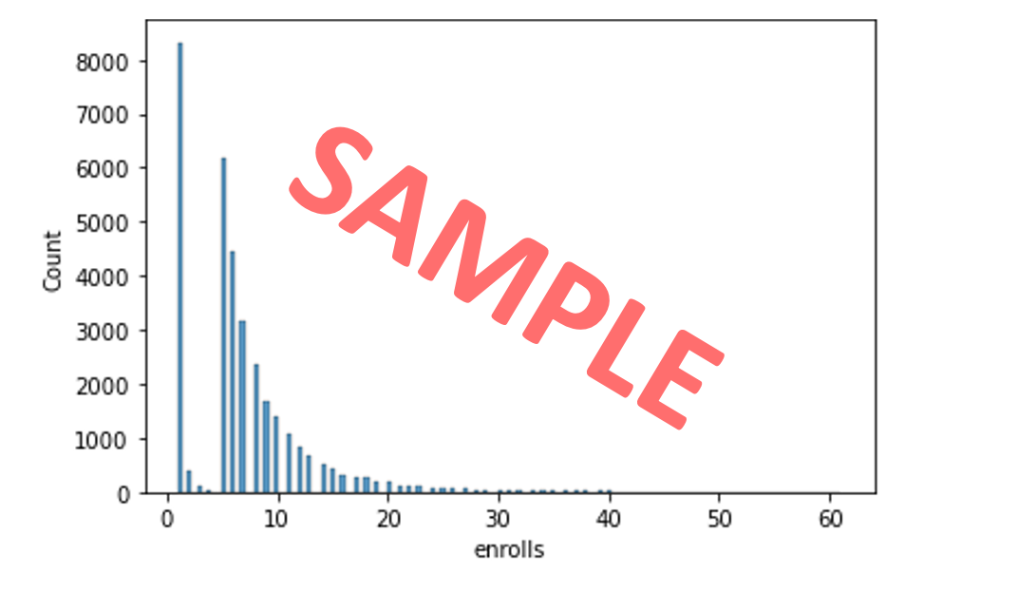
Course enrollment distribution
Notes:
From the histogram, where each bar at a tick number ,x, represents the number of users enrolled in a total of x courses. Shows that by far, over eight thousand users enrolled in only one course. In fact, the majority of users enrolled in under 10 courses. Interesting to note is that the second highest number of courses enrolled in is five and the number of courses after that have only a decreasing number of users.

Slide 7
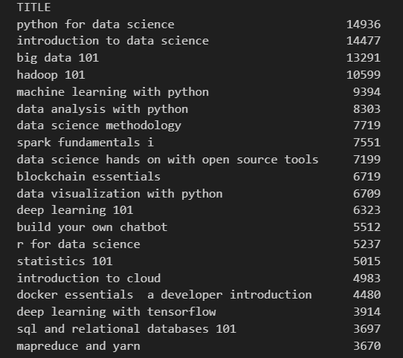
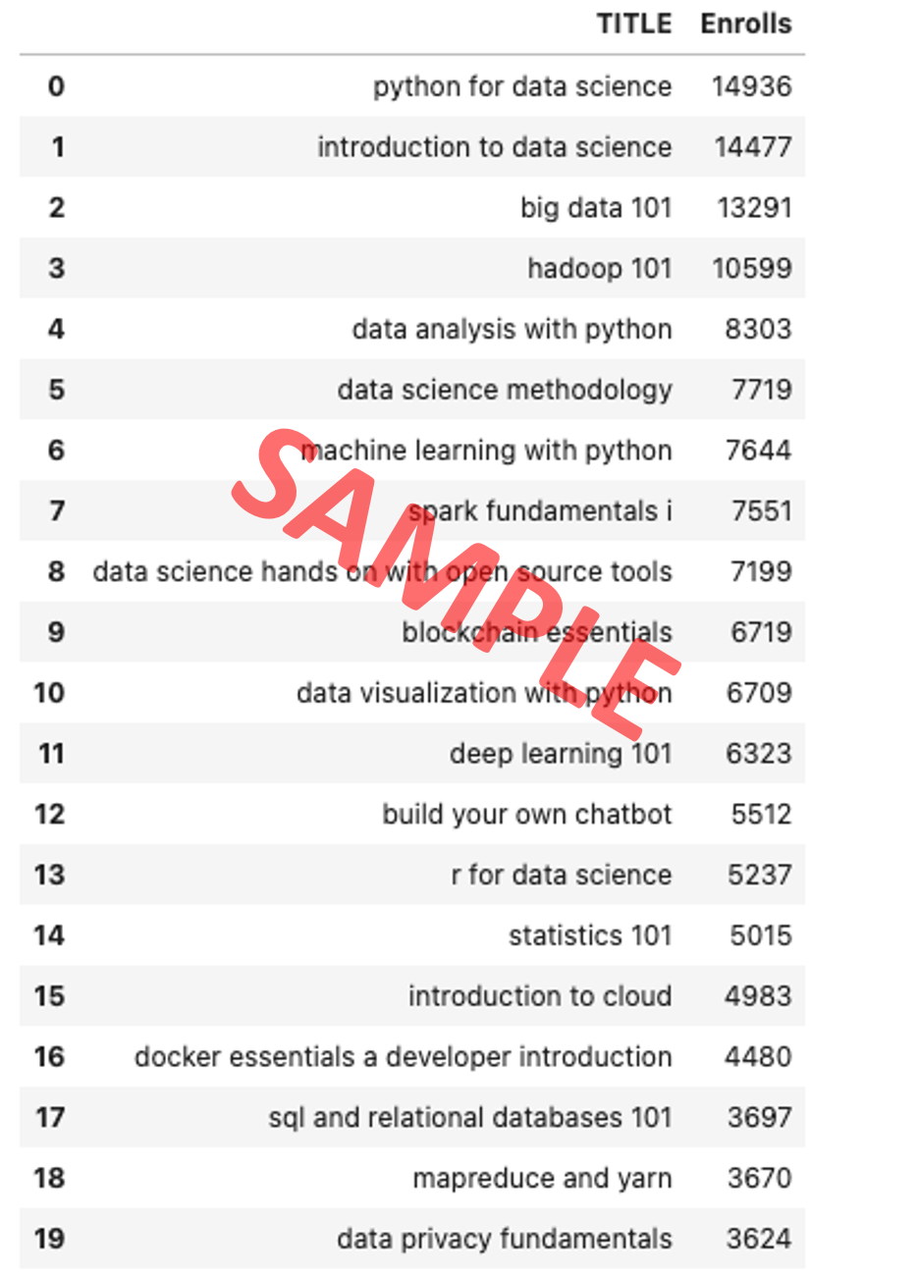
20 most popular courses
Notes:
The 20 most popular courses and their respective number of enrolled students is above. As you can see most popular course is Python for Data Science with almost 15,000 enrolled students. The next most popular course is Introduction to Data Science, which indicates that Data Science courses are in high demand. Interestingly enough, the top 20 most popular courses range from 3600 to 14,000 enrollments which indicates a heavily right skewed distribution.

Slide 8
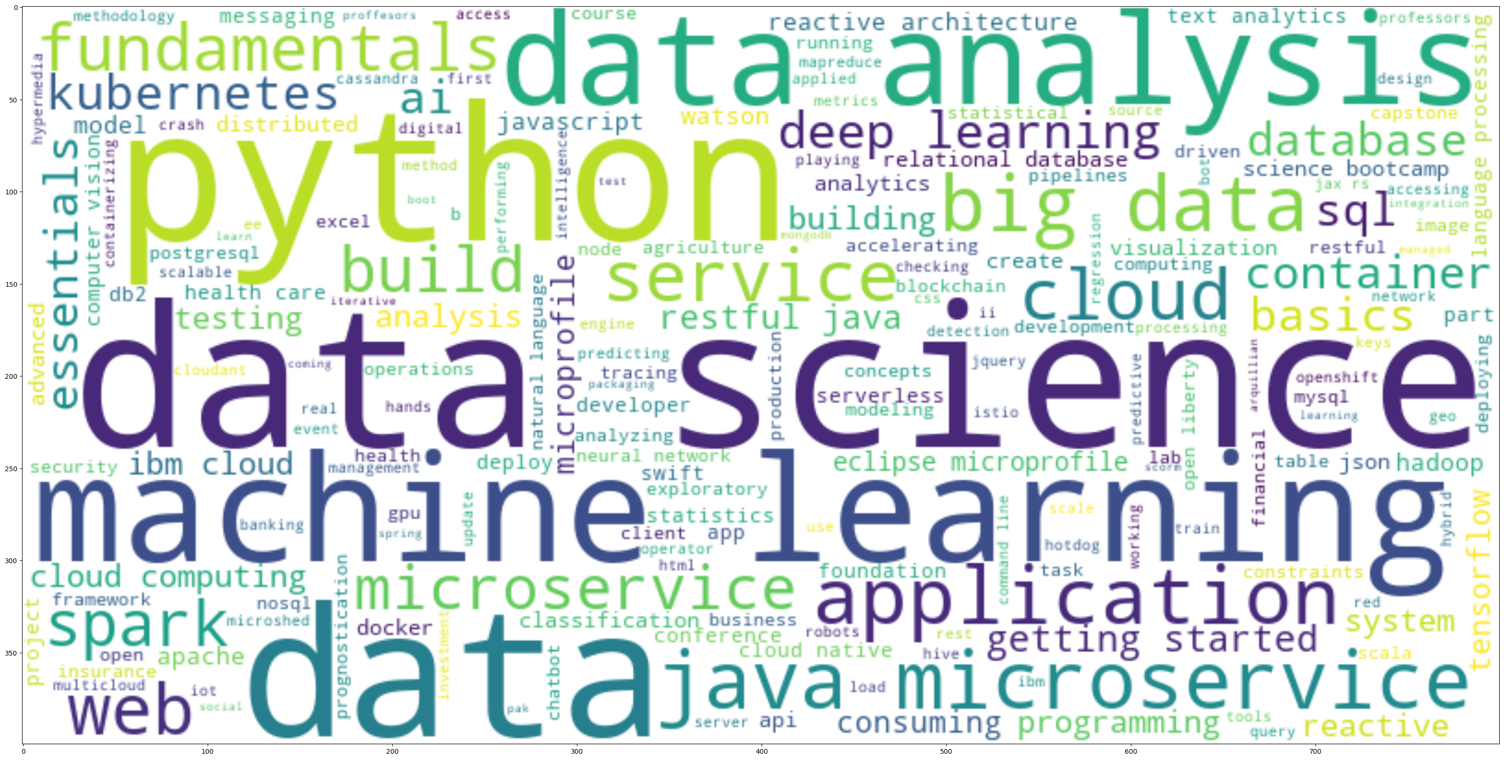
Word cloud of course titles
Notes:
The Word cloud was generated form the words from the course titles in the course_df dataframe from the course_genre.csv file. As we can see from the largest font-size words of “python”, “data science”, “data”, and “machine learning”, many of the course titles involved those words/phrases.

Slide 9
Content-based Recommender System using Unsupervised Learning
Cluster2
Cluster1

Slide 10
Flowchart of content-based recommender system using user profile and course genres
If the unenrolled course meets the recommendation threshold, then recommend it
Compute the Weighted Unenrolled Course score for each unenrolled course (P dot U_i)
Load the user profile (P) vector and course genre ( C) matrix
Build the user’s unenrolled course genre matrix, U
Load the Raw data
Notes:
In order to implement the content based recommender system, I needed a user’s profile vector (P) generated from the courses the user has enrolled in and their related genres. From the loaded course matrix., I then build an unenrolled courses list based on the courses not listed in the user courses. From there, I build a matrix where the rows are the users’ unenrolled courses and the columns are the genres available with their associated indications of the genres used. Then I take the dot product of the user’s profile vector and each row of the unenrolled course genre matrix to build a vector of recommendation scores for the unenrolled courses. All the scores that meet or exceed the threshold will be recommended to the user

Slide 11
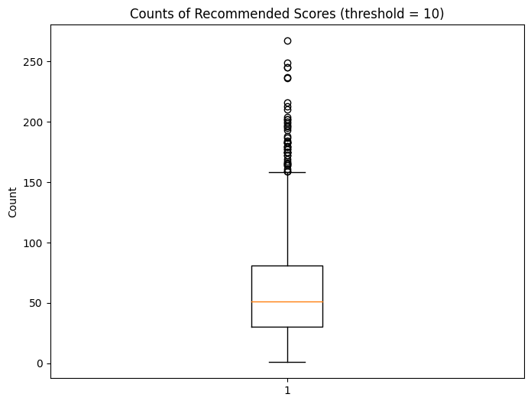
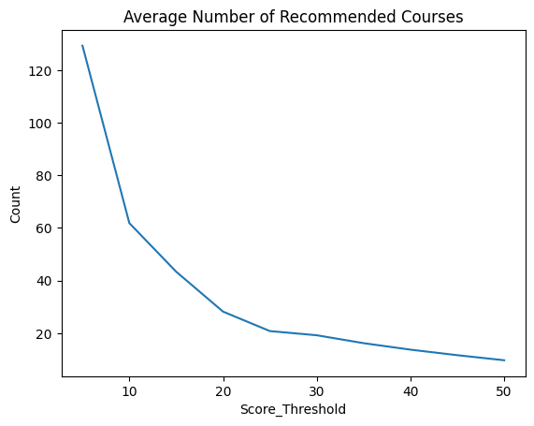
Evaluation results of user profile-based recommender system
What are the most frequently recommended courses?
For a score threshold of 10
TA0106EN 608
GPXX0IBEN 548
excourse22 547
excourse21 547
ML0122EN 544
excourse06 533
excourse04 533
GPXX0TY1EN 533
excourse31 524
excourse73 516
For a score threshold of 50
excourse73 50
excourse72 50
TMP0105EN 49
SC0103EN 37
excourse31 36
RP0105EN 33
GPXX097UEN 27
excourse71 27
excourse70 27
excourse42 27
Based on a threshold score of ten, 61.8 courses have been recommended per user (in the test user dataset). But when the threshold score is at over 25, the average will be under 20 courses.

Slide 12
Flowchart of content-based recommender system using course similarity
If the similarity score meets the threshold for any of my selected courses, then recommend the course
Load the raw data
Identify a user’s selected courses
Build a list of unselected courses
Check the similarity score for each unselected course to any of my selected courses
Notes:
Load the course matrix (provides course information) ,similarity scores (similarity for each course in course matrix) , and test users matrix (information about courses enrolled). For each user, extract the list of enrolled/selected courses to compile a list of unselected courses. For each course in the unselected courses, determine a similarity score for between each of the selected courses. If the similarity score meets the threshold for any of the other enrolled courses, then add the course to the recommended list.

Slide 13
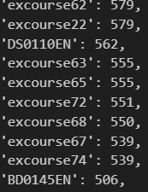
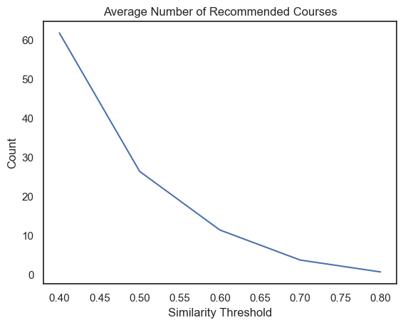
Evaluation results of course similarity based recommender system
On average, with a standard similarity threshold of 0.6, there are 11.7 new/unseen courses recommended per user (in the test user dataset). As the similarity threshold increases, the average number of recommended courses decreases.
The most frequently recommended courses with counts (threshold = 0.6):

Slide 14
Flowchart of clustering-based recommender system
Perform k-means clustering on the PCA transformed features of the user profile vectors to cluster the users
Generate course recommendations based on the popular courses in the same cluster
Load the raw data
Normalize user profile features
Notes:
Loading the user profile (based on genres) vectors, I normalized them with a standard scaler. Using PCA, I performed dimensionality reduction of the 14 course genre features to 9 features (for 90% of the variance). Together with the hyperparameter turning to find the optimal k clusters (11) I clustered the users and then merged the test_users with the clustering labels based on the enrolled course. Then for each user I generated a list of cluster classes that they had not enrolled in so I could provide the list of recommended courses per user.

Slide 15
Evaluation results of clustering-based recommender system
The average number of new/unseen courses recommended per user (in the test user dataset) is
70.291.
The top-10 commonly recommended courses with the amount of times they are recommended:
1 . DW0101EN : 959
2 . TA0105 : 955
3 . DS0201EN : 938
4 . TA0105EN : 934
5 . BD0145EN : 933
6 . AI0111EN : 933
7 . BD0123EN : 919
8 . DB0151EN : 918
9 . ML0122ENv1 : 917
10 . ML0120EN : 905

Slide 16
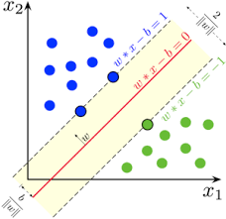
Collaborative-filtering Recommender System using Supervised Learning

Slide 17
Flowchart of KNN based recommender system
Predict the ratings for the test set using the trained model
Load the raw data of the user course ratings
If need be, convert the dataframe to be sparse
Train the KNN model on the train data
Split the data into train and test datasets
Notes:
This method is based on using the scikit-surprise package and a give dataset of user, course ratings. After loading the raw data of the users course ratings, I transformed the dataframe to a sparse dataframe where the users are the index and the courses are the columns. I then split the data into a 70% training dataset and 30% testing dataset. I then trained the KNN model on the train data in order to find the k-nearest neighbors for each user. Afterwards, for each cluster a test user belonged to, I performed the matrix multiplication/dot product with the user course ratings dataframe to calculate the predicted ratings

Slide 18
Flowchart of NMF based recommender system
Predict the ratings for the test set using the trained model
Load the raw data of the user course ratings
If need be, convert the dataframe to be sparse
Train the NMF model on the train data
Split the data into train and test datasets
Notes:
This method is based on using the scikit-surprise package and a give dataset of user, course ratings. After loading the raw data of the users course ratings, I transformed the dataframe to a sparse dataframe where the users are the index and the courses are the columns. I then split the data into a 70% training dataset and 30% testing dataset.

Slide 19
Flowchart of Neural Network Embedding based recommender system
Construct the user and item one-hot encoding datasets
Split the encoded dataset into training, testing and validation datasets
Build/Compile the Neural Network model architecture
Train the model on the training data to retrieve the output vector with the predicted ratings
Load the user item rating raw data
Notes:
I uploaded the user item rating raw data set. Through one-hot encodings for the different 33,901 users and the 126 items. I then split the encoded datasets into train, test and validation datasets. I then constructed a neural network using the Recommender net class that took the two inputs (user encoding vector and item encoding vector) and embedded them into their respective 16 x 1 vectors, then applied the dot product of the resulting 16x1 embedding vectors with a Adam optimization.

Slide 20
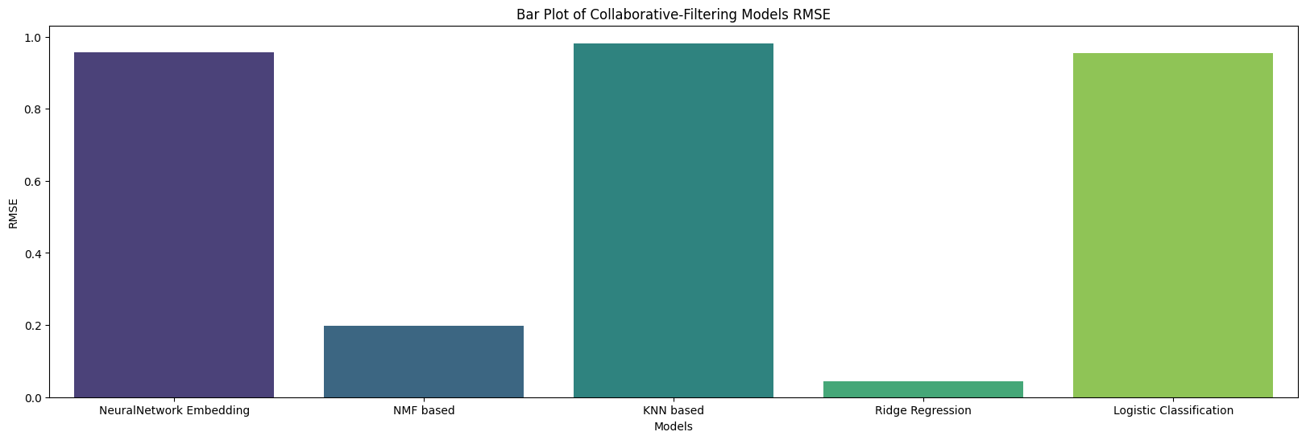
Compare the performance of collaborative-filtering models
Notes:
From the previous labs and the models built where the root mean squared error could be calculated, I compiled their RMSEs from hypertuned parameter models and saw that the regression based and NMF had the better results with the lower root mean squared error, while the neural network and KNN and Logistic classification models performed relatively the same.

Slide 21
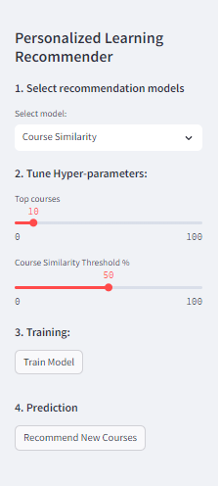
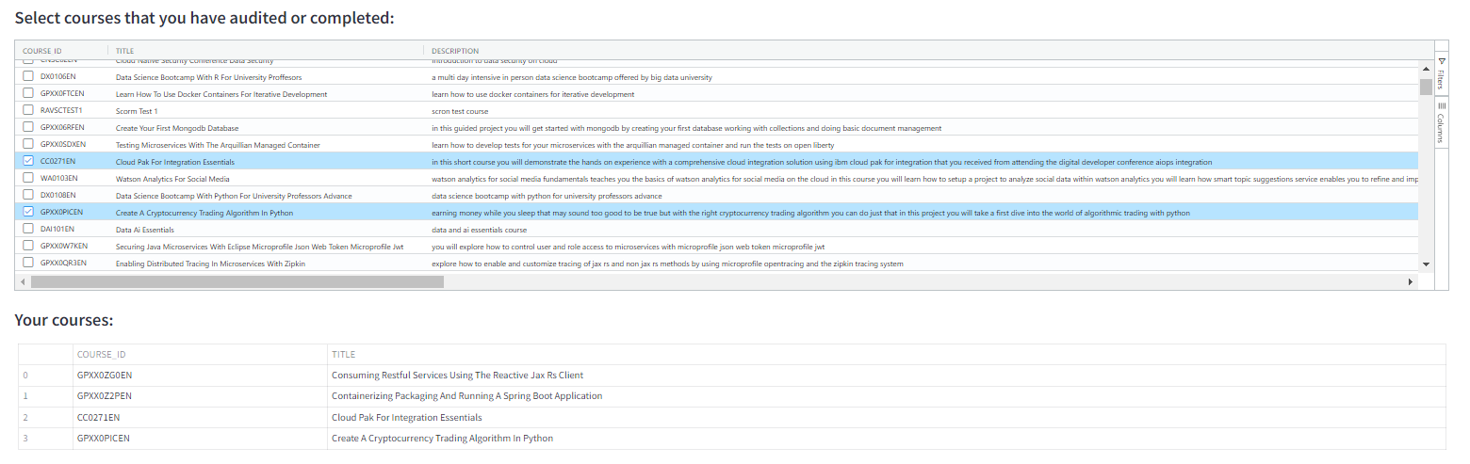
Optional: Build a course recommender system app with Streamlit
Streamlit app screenshot2
A published Streamlit App URL for a live demo

Slide 22
Conclusions
The varying RMSEs for the different approaches indicated that parameter hypteruning and testing of different models is necessary to confirm an optimal model.
Additional user information beyond the courses they enrolled in would be helpful especially for latent layers of neural networks and clustering. For example, the time it took to complete the course, if any of the courses had pre-requisite courses, and the completion percentage of the curses, would be very useful at clustering courses and users.
I would love to track the results of the suggesting the recommended courses to the users and see what percentage of the recommended courses are enrolled and completed.

Slide 23
Appendix
Github repo: https://github.com/kymayodeji/recommender

